Slide 1

Sportswear Analysis

Slide 2

Outlines 1. Introduction 2. Most Important Insights (EDA) 3. Smarter Decisions

Slide 3

Introduction Data analysis plays a crucial role in developing a successful sportswear strategy, helping companies to make informed decisions that drive growth and profitability. By gathering and analyzing data on customer preferences, market trends, and sales performance, sportswear companies can make informed decisions about product design, marketing campaigns, pricing, and distribution.

Slide 4
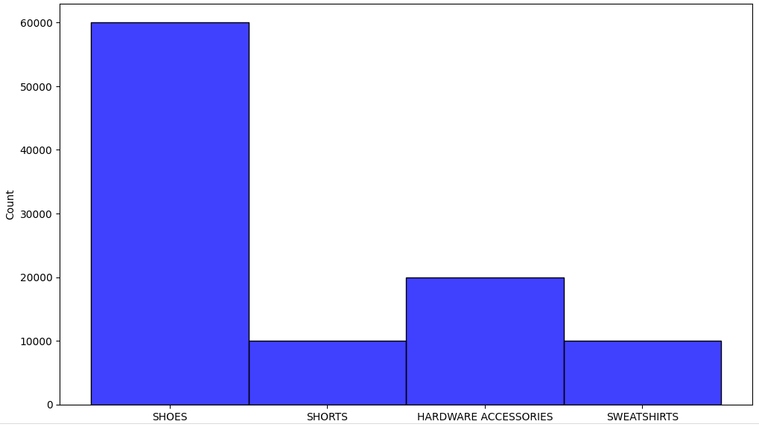
Some Insights from EDA
Product group Dist.

Slide 5
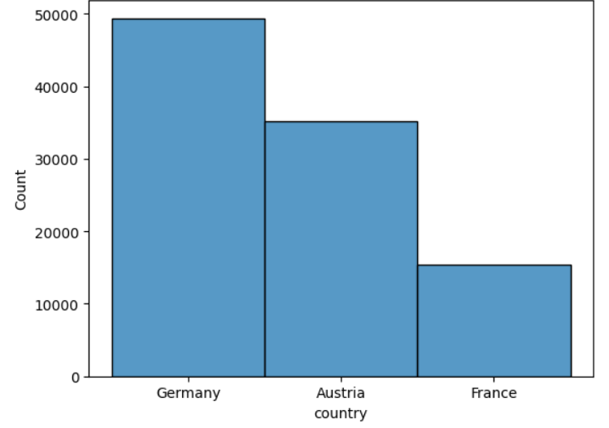
Country Dist.

Slide 6
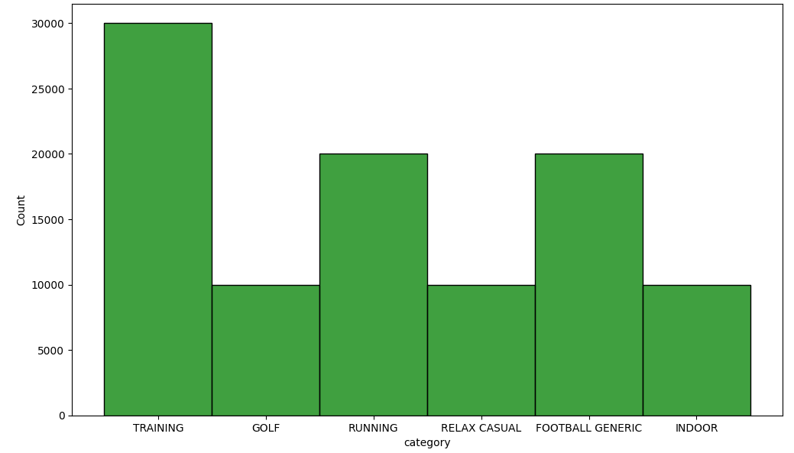
Category Dist.

Slide 7
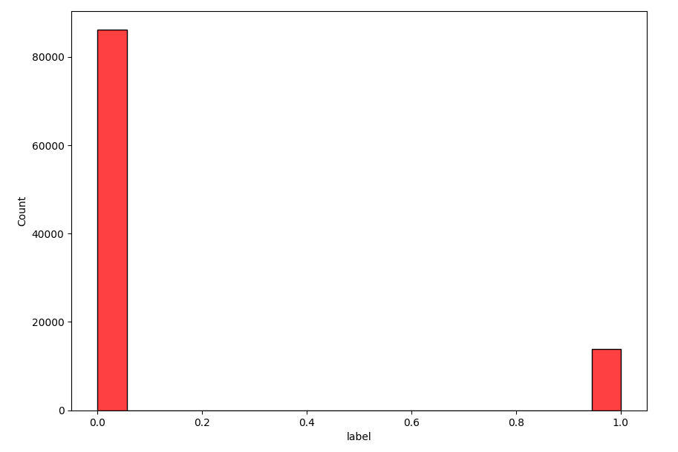
Label Dist.
#Imbalanced

Slide 8
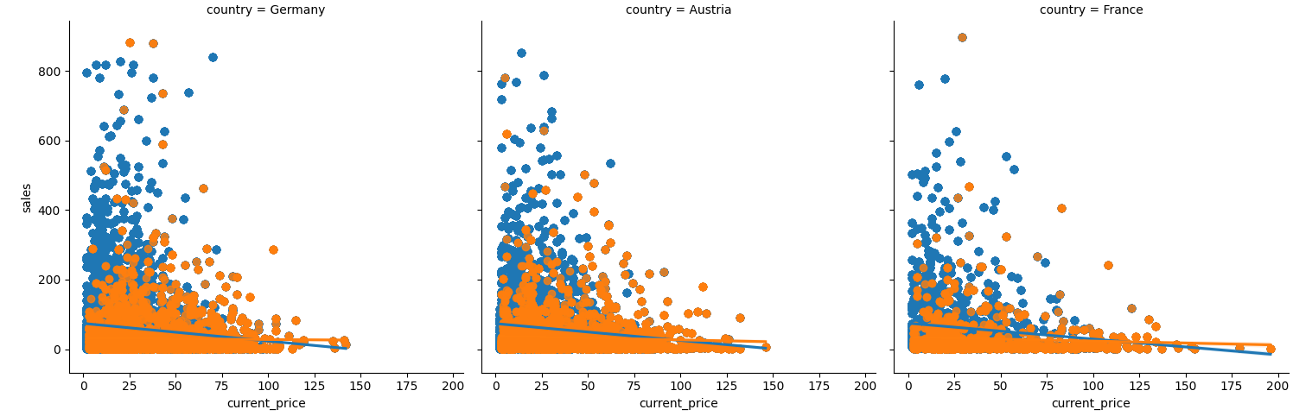

Slide 9
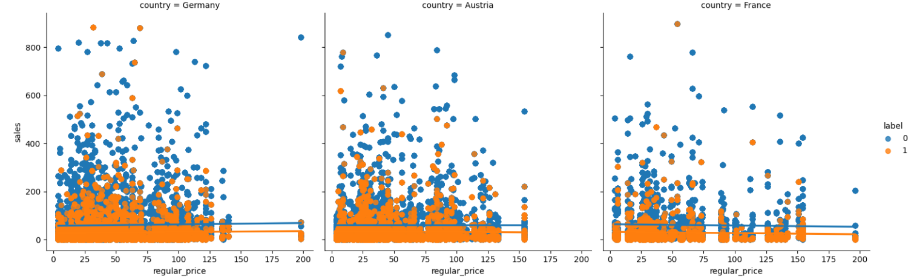

Slide 10
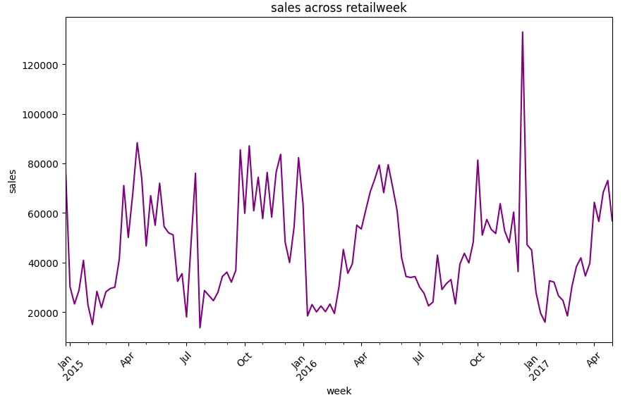

Slide 11
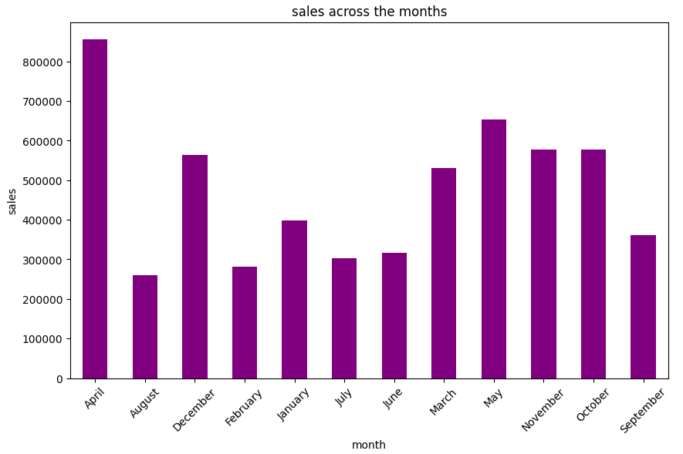

Slide 12
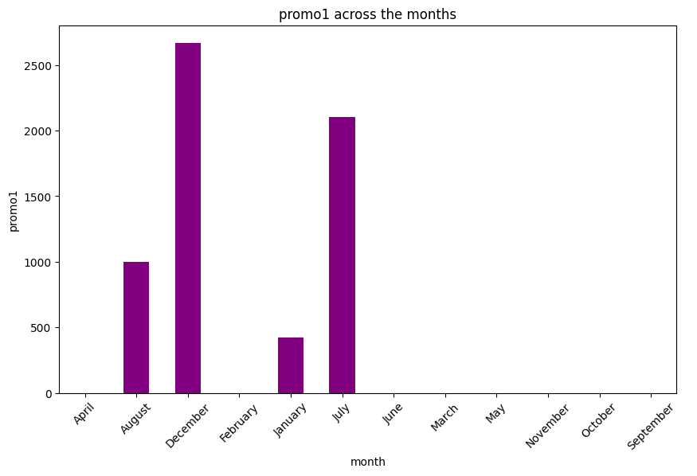

Slide 13
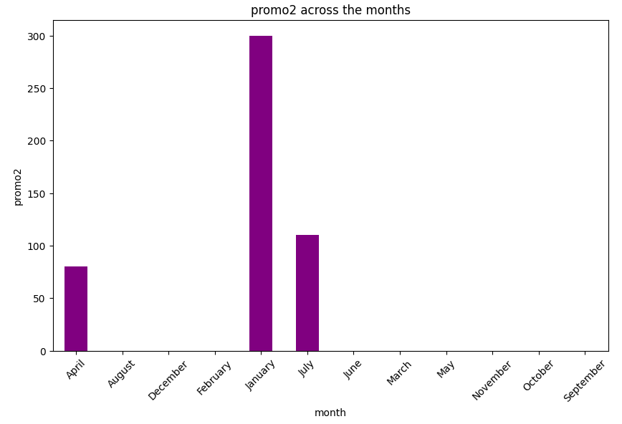

Slide 14
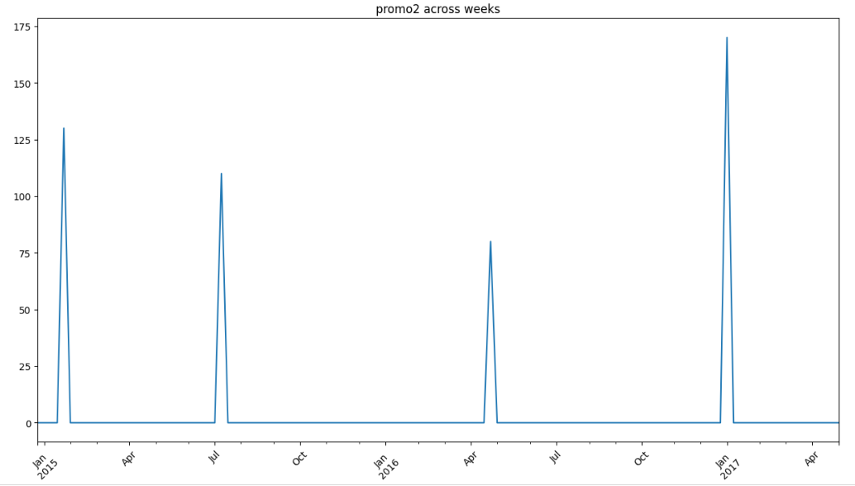

Slide 15
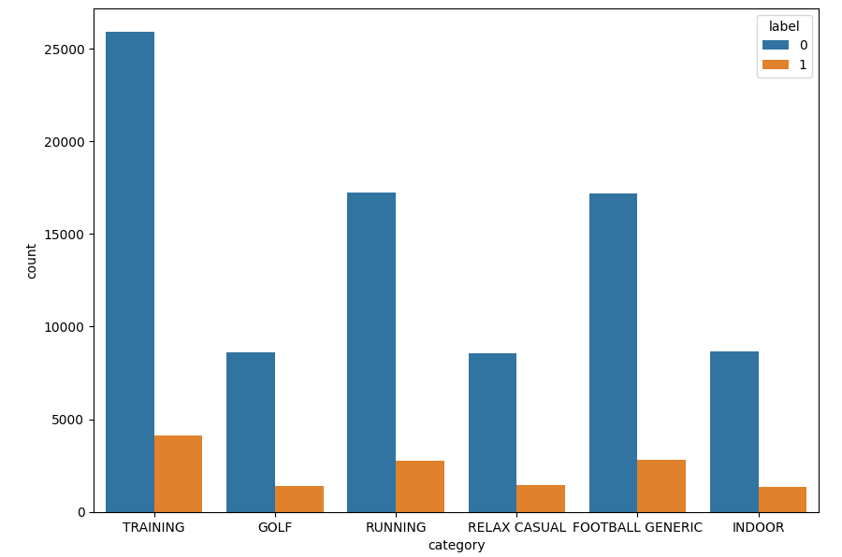

Slide 16
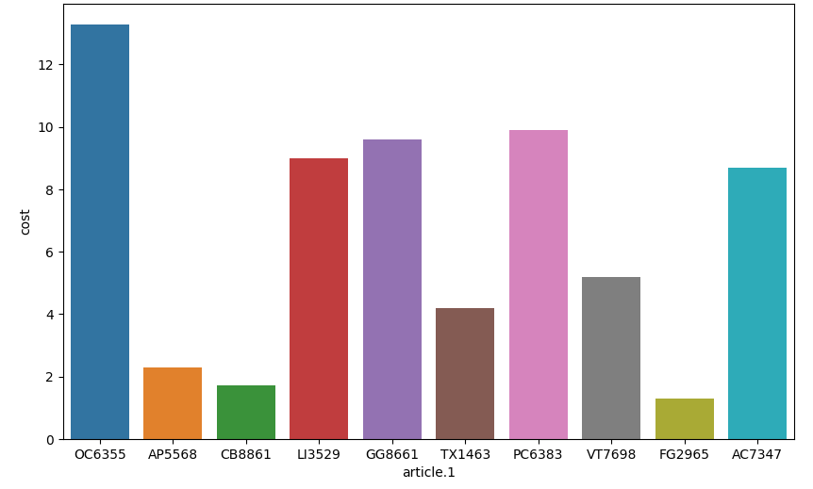

Slide 17
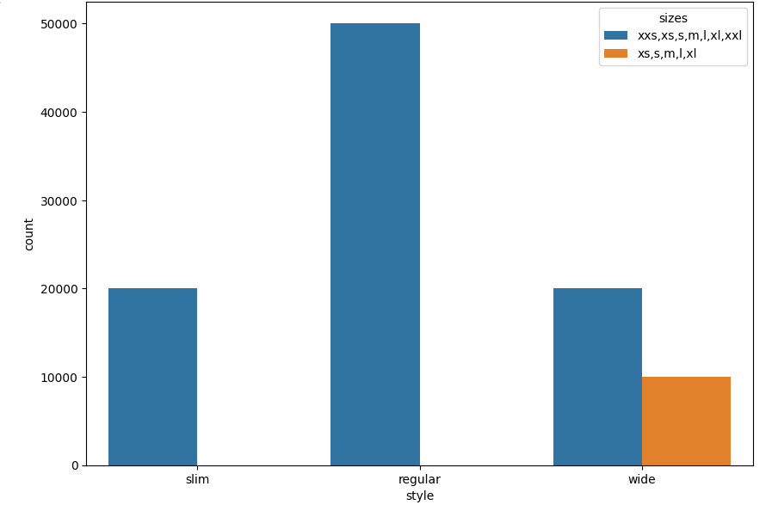

Slide 18
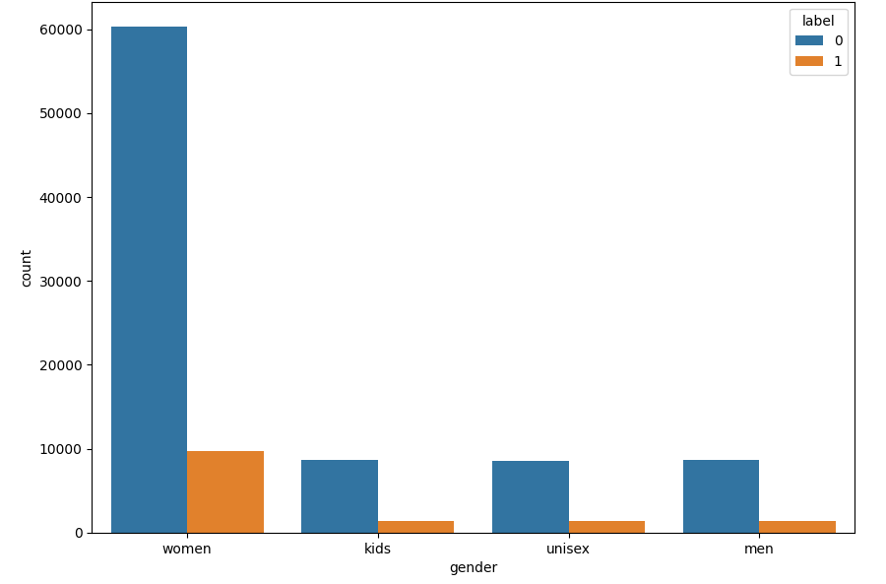

Slide 19
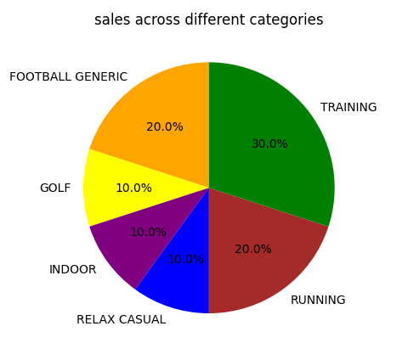
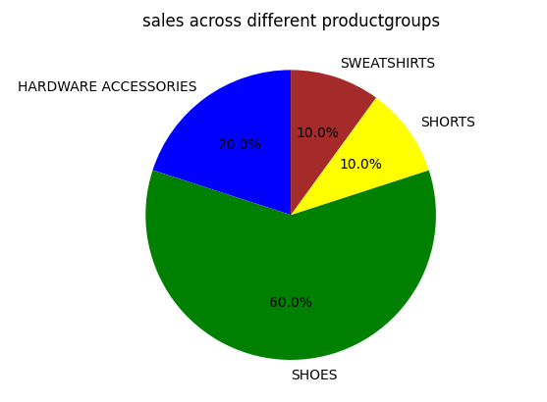
#other statistics insights are included through the notebook

Slide 20
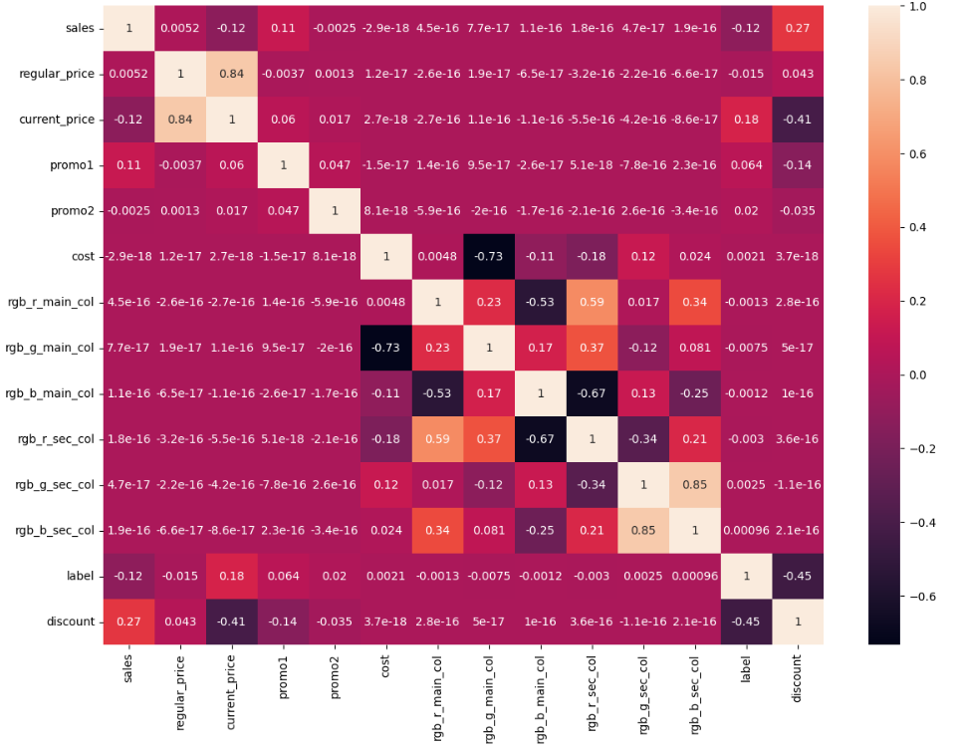

Slide 21
Smarter Decisions
Classification Model on the label to predict the effect of offering and advertisement and finally satisfy both marketing and management teams.
Cost estimation accounts for each element required for the project—from materials to labor—and calculates a total amount that determines a project's budget.
Customer segmentation: the process of dividing a customer base into distinct groups of individuals that have similar characteristics. This process makes it easier to target specific groups of customers with tailored products, services, and marketing strategies.

Slide 22
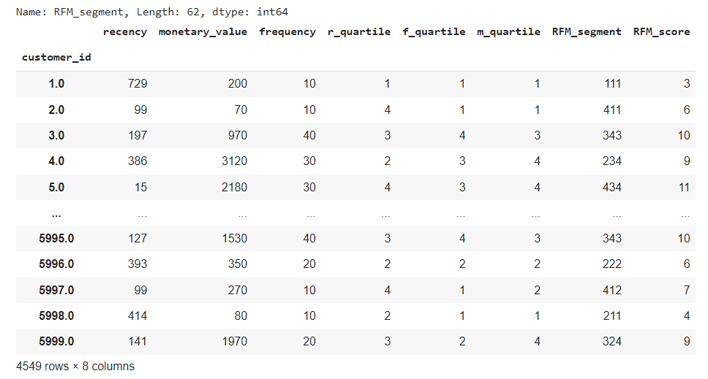
RFM Segmentation
#This File is attached in csv format

Slide 23
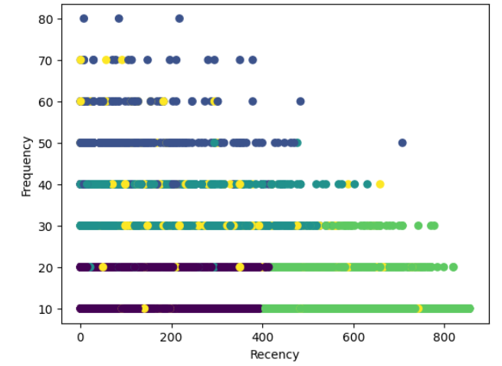
Behavioral Segmentation

Slide 24


